Slide 1

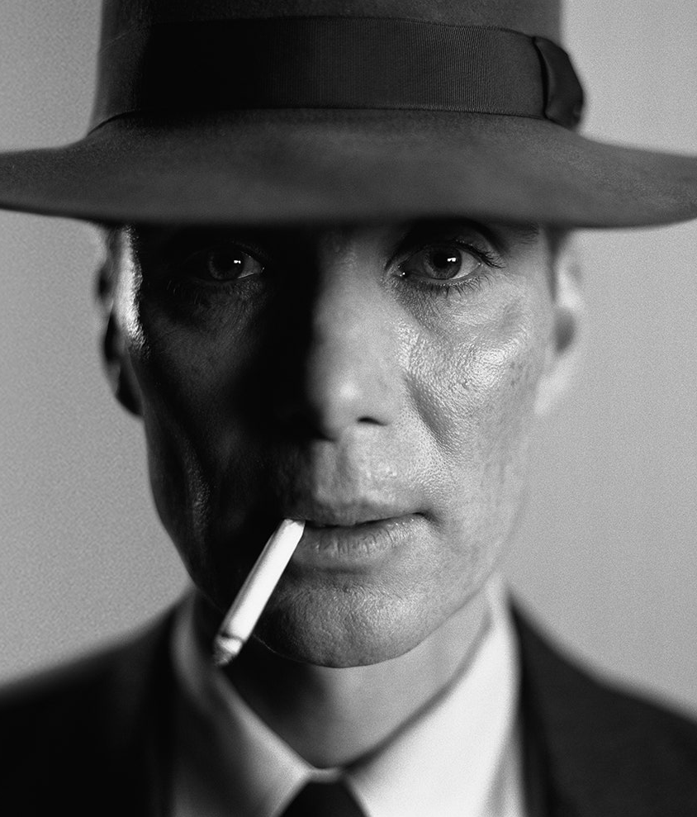

OFFICIAL
FAN CLUB
MEMBERSHIP #
9034895850
NAME
J. Robert Oppenheimer
DATE OF BIRTH
22 April 1904
OCCUPATION
Theoretical physicist
This is to certify that the above-named Barbie Fan is a member in good standing of the national barbie Fan Club and is entitled to all rights and privileges pertaining thereto.

Slide 2

BARBIE NEWS
EXTRA
EXTRA
OPPENHEIMER REGRETS CREATING THE ATOMIC BOMB.
Nuclear bomb test detonation carried out in the desert of New Mexico in 1945.

Slide 3



“Now I am
become Death, the
destroyer of worlds.”

Slide 4



Top facts about Oppenheimer
Had many affairs in his lifetime
Developed 1st atomic bomb during WW2
Opposed nuclear weapons afterwards

Slide 5


B A R B I E

Slide 6
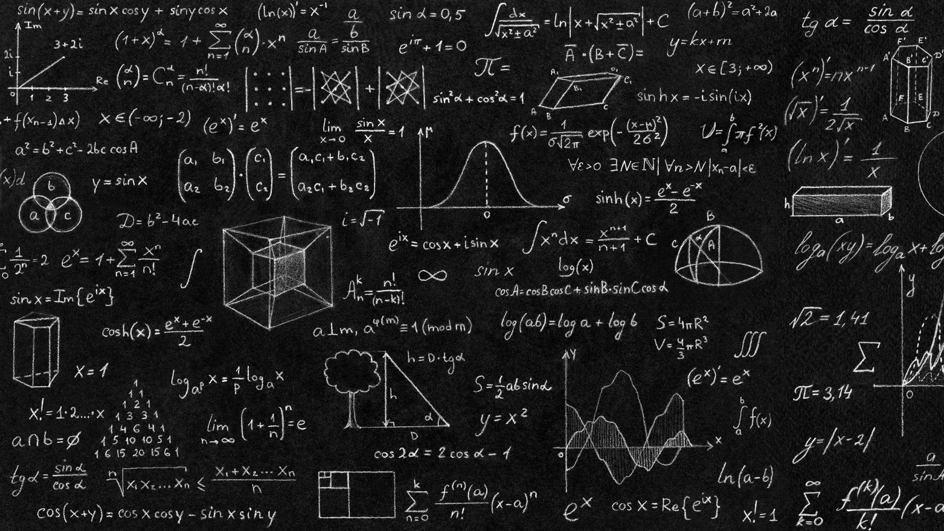

“
LIFE IN PLASTIC, IT’S FANTASTIC
”

Slide 7



Oppenheimer
This Ken is the father of the atomic bomb

Slide 8
BARBIE NEWS
EXTRA
EXTRA
“Now I am become Death, the destroyer of worlds.”
OPPENHEIMER, AFTER WITNESSING THE FIRST TEST OF THE ATOMIC BOMB

